Slide 1
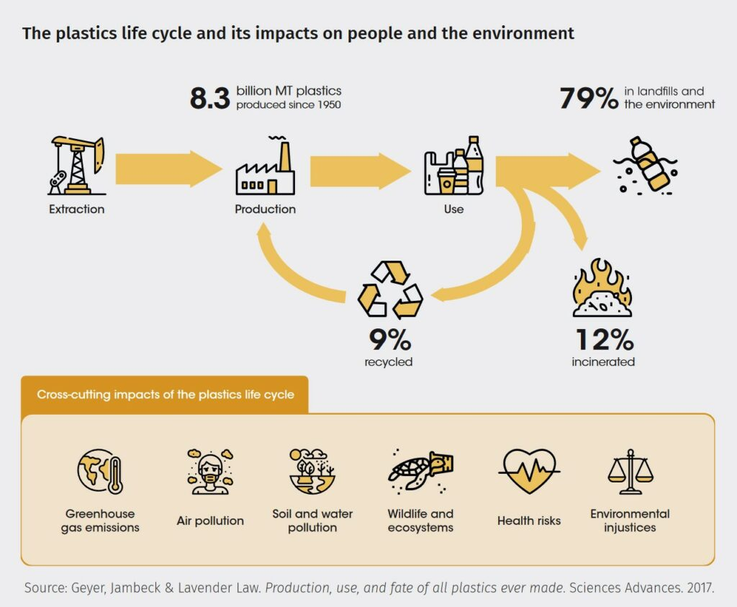
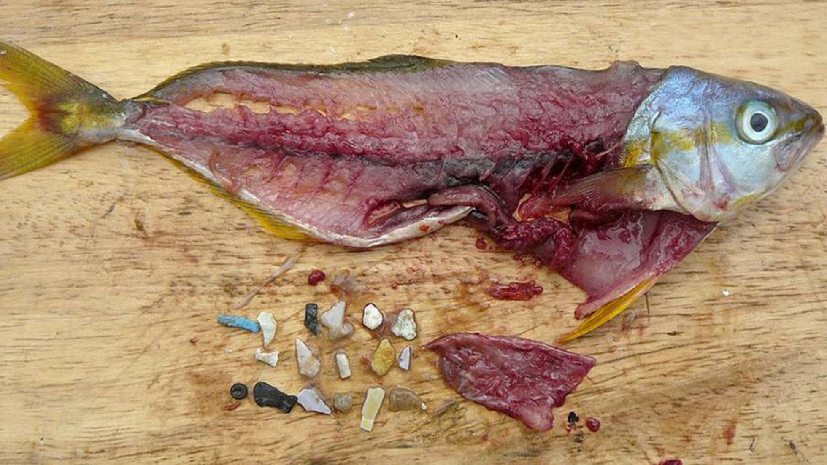
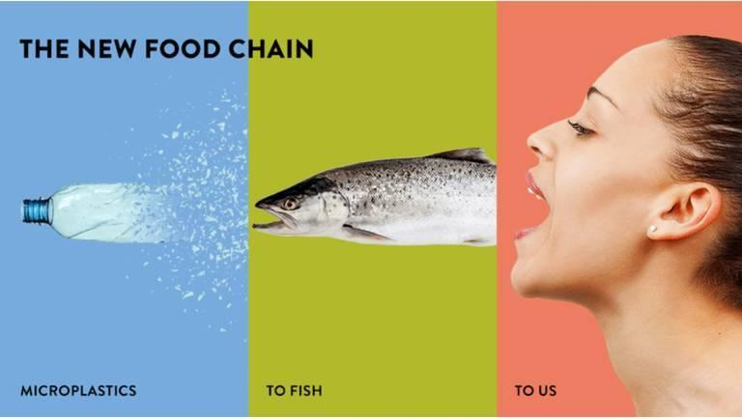
Less Plastic in our Schools
the responsibility of the destiny of the plastic its yours!
Plastics, the point
Where the plastic come?
We all know “what is the plastic”,, unfortunately, its somethign that are around us eveytime, but, where it comes and why is so dangerous? What we can do for our planet?
Plasitc is a synthetic compound that is difficult to be removed by nature, being produced by industry, it becomes our power to choose wich end of the plastic we buy
400 years!!
Plastic can take over 400 years to decompose. During this time, it accumulates, contaminating the fauna and flora, which we use as food
Why is so danger?
Plastic is everywhere: in the ocean, in the river, and in animals bodies!
Do you remembre that plastic bag that you threw away?
Well, maybe one turtle ate it and died
The plastic we produce, it is the plastic we consume.
Microplastics are something “hidden”, many animals eat it, and probably you will eat one of those animal! The problem isn´t in animal itself, but in us a society
Opting for glass containers;
Recycle and reuse;
Stop ignoring plastic on the floor;
Substitute plastic bags for ecologic bags;
Reduce the consumption of disposable cups, etc;
Avoid the use of cosmetics that have microplastic
What can we do?
The future start now! Start when you reclycle plastic and do the better for everyone
4th mobility, 10th - 14th October 2022 Greece

